Slide 1
IMSE 802 Supply Chain Operations and Decision Making
Lecture 3
Supply Chain Models

Slide 2
Supply Chain Models
Supply Chain Models
Transportation Model – LP
Product Mix Model – LP
Warehouse and Inventory Level Optimization Model Example

Slide 3
Supply Chain Decision Levels
Strategic
Long-term decisions and objectives
High-level decisions, i.e., facility location, supplier selection, supply chain design, etc.
Tactical
Midterm decisions concerning issues such as transportation planning, distribution planning, etc.
Operational
Short term decisions which are concerned with daily managerial activities such as inventory planning, demand planning, forecasting, etc.

Slide 4
Supply Chain Models
How do we analytically address planning and execution at each of these levels?
What tools can we use to best manage the supply chain overall and the individual elements of the supply chain?
What type of IT infrastructure do we need to support these processes?

Slide 5
Supply Chain Models
A variety of optimization and supply chain models exist that can be used to assist us in our decision making.
Much research is done in a variety of these areas
System exist that are implemented to assist us in these decision making processes.

Slide 6
Supply Chain Models
Decisions need to be supported by robust tools to enable managers to evaluate the impact of their decisions prior to making them.
System modelling is used to model the real system.
These models can be mathematical models or simulation models.
System complexity can make mathematical models difficult to implement in practice.

Slide 7
Supply Chain Models
The interaction between supply chain components (i.e., manufacturing plants, retailers, warehouses, and distribution centers) defines its complicated behavior and is very difficult to build analytical expression that describes it precisely.
Simulation is one of the most successful tools for analyzing supply chain processes.

Slide 8
Supply Chain Models
Optimization Methods in Supply Chain Applications: a Review, Conference Paper, Dublin Institute of Technology, Amr Arisha and Waleed Abo-Hamad, 12th Annual Conference of the Irish Academy of Management, Galway Mayo Institute of Technology, Galway, 2-4 September 2009.

Slide 9
Supply Chain Models
Optimization Methods in Supply Chain Applications: a Review, Conference Paper, Dublin Institute of Technology, Amr Arisha and Waleed Abo-Hamad, 12th Annual Conference of the Irish Academy of Management, Galway Mayo Institute of Technology, Galway, 2-4 September 2009.

Slide 10
Supply Chain Models
Optimization Methods in Supply Chain Applications: a Review, Conference Paper, Dublin Institute of Technology, Amr Arisha and Waleed Abo-Hamad, 12th Annual Conference of the Irish Academy of Management, Galway Mayo Institute of Technology, Galway, 2-4 September 2009.

Slide 11
Supply Chain Models
General Problem Formation
Optimize f_{i}(x) i = 1,…,I
Subject to g_{j}(x) <=0 j = 1,…,J
h_{k}(x) = 0 k = 1,…,K
Where f_{i}(x) is the objective function i, x represents the decision variable vector and g_{i}(x), h_{i}(x) are the set of inequality and equality constraints

Slide 12
Supply Chain Models
Challenges
Obtaining a true mathematical description of f_{i}(x) is not attainable
Traditional optimization is not adequate for complex problems
There are typically multiple objectives that must be optimized concurrently.
A large number of variables are encountered with large ranges

Slide 13
Supply Chain Models
Optimization Methods in Supply Chain Applications: a Review, Conference Paper, Dublin Institute of Technology, Amr Arisha and Waleed Abo-Hamad, 12th Annual Conference of the Irish Academy of Management, Galway Mayo Institute of Technology, Galway, 2-4 September 2009.

Slide 14
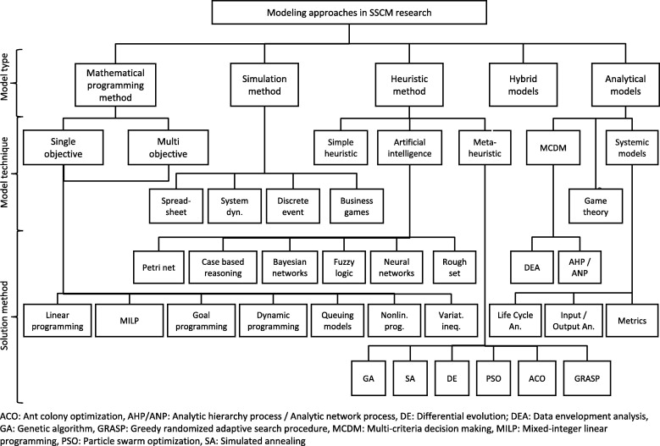
Supply Chain Models
https://www.sciencedirect.com/science/article/pii/S037722171300787X

Slide 15
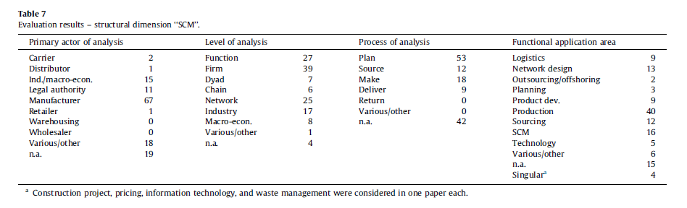
Research Survey – Dimensions of SCM
(1) The primary actor that is the focus of the study
(2) The organizational level of analysis ranging from internal functions to broad macro-economic focus;
(3) The SCOR process covered in the model, and
(4) The functional application area in the model (e.g. SCM, logistics, or product development).
https://www.sciencedirect.com/science/article/pii/S037722171300787X

Slide 16
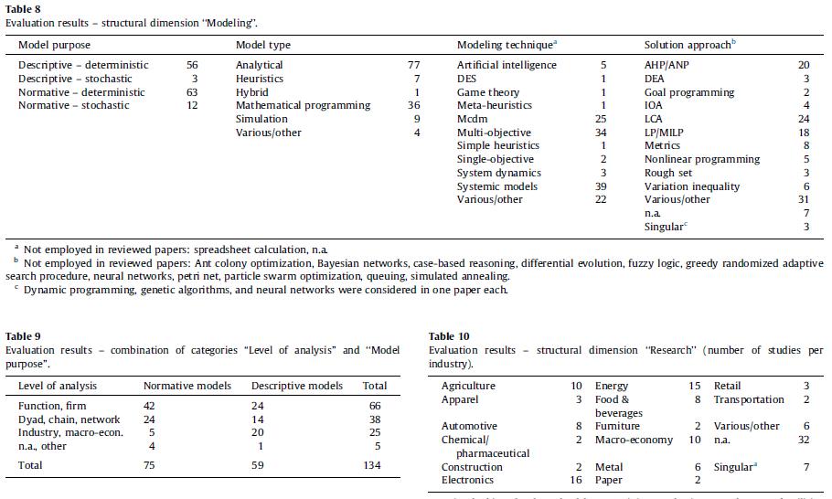
Research Survey - Modeling
https://www.sciencedirect.com/science/article/pii/S037722171300787X

Slide 17
Supply Chain Models
Many methods exist
Many parameters need to be modeled in the supply chain
Results must represent real-world operations to be useful
Over-complication may make using the model difficult

Slide 18
Optimization Models
Linear Programming (LP) Models in Supply Chain Management
LP models allow us to model a component of the supply chain to optimize the objectives and constrain the solution based on available resources
LP models can be used in a variety of areas of the supply chain

Slide 19
LP Models Applying to Supply Chains
Type of Model | Variables | Function to Optimize | Typical Constraints
Product Mix | Number of products to produce | Maximize contribution to profit | Resource limits, such as time, labor, material; maximum or minimum quantities
Blending | Amount of materials to combine to produce one unit of product | Minimizing cost | Resource limits; demand requirements
Production line scheduling | Sequence of production | Minimize cost | Resource limits; time requirements
Inventory | Number of inventory items to order by period | Minimize cost (sum of production and inventory) | On-hand minimums by time period; inventory balance equations
Transportation | Assign sources for distribution of goods to demands | Minimize cost | Capacity limits at sources; demand requirements
Assignment | Assign sources of resources to tasks | Minimize cost | Conventional sources and demand capacities equal 1

Slide 20
LP Models with Supply Chains
Components
Variables – Items that can be varied in order to improve or positively contribute to the objective
Functions in terms of variables – mathematical statements measuring something in terms of the variables
Limits to Functions – Limitations imposed on the problem or environment

Slide 21
LP Models with Supply Chains
Components
Focus on the decision to be made
Focus on things that are within the decision-maker’s control
Identify the objective of the decision
Set limits and insure that all limits are captures

Slide 22
Example – Shipping Schedule
Deliver petroleum from refineries to depots.
Refineries
Houston
Corpus Christi
Fort Worth
Depots
San Antonio
Bryan
El Paso

Slide 23
Example – Shipping Schedule
System Parameters
Refinery | Capacity (Thousand gallons) | Depot | Requirements (thousand gallons)
Houston | 150 | San Antonio | 200
Corpus Christi | 100 | Bryan | 120
Fort Worth | 250 | El Paso | 180

Slide 24
Example – Shipping Schedule
Shipping Unit Costs
Source | (S) San Antonio | (B) Bryan | (E) El Paso | Supply (thousand gallons)
(H) Houston | $200 | $90 | $50 | 150
(C) Corpus Christi | $60 | $100 | $180 | 100
(F) Fort Worth | $20 | $150 | $120 | 250
Demand (thousand gallons) | 200 | 120 | 180 | 500

Slide 25
Example – Shipping Schedule
Objective function
Minimize transportation costs
Coefficients are unit costs
Variables
Quantity shipped that day of over the indicated route
Constraints
Quantity shipped out of each refinery is less than or equal to the refinery’s capacity
Quantity received by the depot is at least as much supply as is needed to cover demand.

Slide 26
Example – Shipping Schedule
Formulation
Minimize = 200 HS + 90 HB + 50 HE + 60 CS + 100 CB + 180 CE + 20 FS + 150 FB + 120 FE
Subject to:
HS + CS + FS >= 200
HB + CB + FB >= 120
HE + CE + FE >= 180
HS + HB + HE <=150
CS + CB + CE <=100
FS + FB + FE <=250
HS, HB, HE, CS, CB, CE, FS, FB, FE >= 0

Slide 27
Example Shipping - Schedule
Excel Formation
 |  | HS | HB | HE | CS | CB | CE | FS | FB | FE | Function |  | Limit
 | Quantities | 0 | 0 | 0 | 0 | 0 | 0 | 0 | 0 | 0 | 0
 | Costs | 200 | 90 | 50 | 60 | 100 | 180 | 20 | 150 | 120
Supplies | Houston | 1 | 1 | 1 |  |  |  |  |  |  | 0 | <= | 150
 | Corpus Christi |  |  |  | 1 | 1 | 1 |  |  |  | 0 | <= | 100
 | Fort Worth |  |  |  |  |  |  | 1 | 1 | 1 | 0 | <= | 250
Demands | San Antonio | 1 |  |  | 1 |  |  | 1 |  |  | 0 | >= | 200
 | Bryan |  | 1 |  |  | 1 |  |  | 1 |  | 0 | >= | 120
 | El Paso |  |  | 1 |  |  | 1 |  |  | 1 | 0 | >= | 180

Slide 28
Example Shipping - Schedule
Excel Formation – Showing Cell Formulas
 |  | HS | HB | HE | CS | CB | CE | FS | FB | FE | Function |  | Limit
 | Quantities | 0 | 0 | 150 | 0 | 100 | 0 | 200 | 20 | 30 | =SUMPRODUCT($C$2:$K$2,C3:K3)
 | Costs | 200 | 90 | 50 | 60 | 100 | 180 | 20 | 150 | 120
Supplies | Houston | 1 | 1 | 1 |  |  |  |  |  |  | =SUMPRODUCT($C$2:$K$2,C4:K4) | <= | 150
 | Corpus Christi |  |  |  | 1 | 1 | 1 |  |  |  | =SUMPRODUCT($C$2:$K$2,C5:K5) | <= | 100
 | Fort Worth |  |  |  |  |  |  | 1 | 1 | 1 | =SUMPRODUCT($C$2:$K$2,C6:K6) | <= | 250
Demands | San Antonio | 1 |  |  | 1 |  |  | 1 |  |  | =SUMPRODUCT($C$2:$K$2,C7:K7) | >= | 200
 | Bryan |  | 1 |  |  | 1 |  |  | 1 |  | =SUMPRODUCT($C$2:$K$2,C8:K8) | >= | 120
 | El Paso |  |  | 1 |  |  | 1 |  |  | 1 | =SUMPRODUCT($C$2:$K$2,C9:K9) | >= | 180

Slide 29
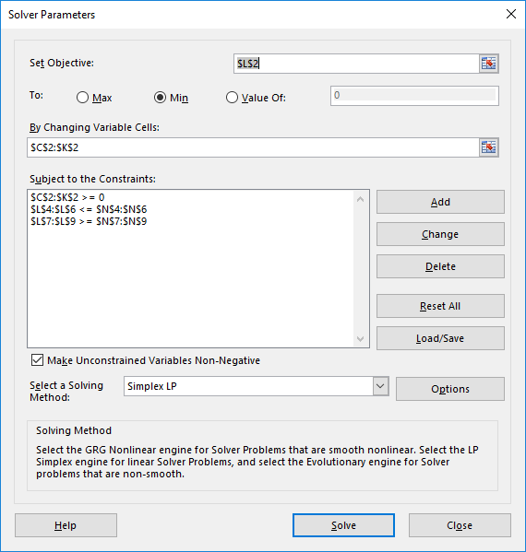
Example Shipping - Schedule
Excel Formation
 |  | HS | HB | HE | CS | CB | CE | FS | FB | FE | Function |  | Limit
 | Quantities | 0 | 0 | 150 | 0 | 100 | 0 | 200 | 20 | 30 | 28100
 | Costs | 200 | 90 | 50 | 60 | 100 | 180 | 20 | 150 | 120
Supplies | Houston | 1 | 1 | 1 |  |  |  |  |  |  | 150 | <= | 150
 | Corpus Christi |  |  |  | 1 | 1 | 1 |  |  |  | 100 | <= | 100
 | Fort Worth |  |  |  |  |  |  | 1 | 1 | 1 | 250 | <= | 250
Demands | San Antonio | 1 |  |  | 1 |  |  | 1 |  |  | 200 | >= | 200
 | Bryan |  | 1 |  |  | 1 |  |  | 1 |  | 120 | >= | 120
 | El Paso |  |  | 1 |  |  | 1 |  |  | 1 | 180 | >= | 180

Slide 30
Example Shipping - Schedule
Excel Formation
 |  | HS | HB | HE | CS | CB | CE | FS | FB | FE | Function |  | Limit
 | Quantities | 0 | 0 | 150 | 0 | 100 | 0 | 200 | 20 | 30 | 28100
 | Costs | 200 | 90 | 50 | 60 | 100 | 180 | 20 | 150 | 120
Supplies | Houston | 1 | 1 | 1 |  |  |  |  |  |  | 150 | <= | 150
 | Corpus Christi |  |  |  | 1 | 1 | 1 |  |  |  | 100 | <= | 100
 | Fort Worth |  |  |  |  |  |  | 1 | 1 | 1 | 250 | <= | 250
Demands | San Antonio | 1 |  |  | 1 |  |  | 1 |  |  | 200 | >= | 200
 | Bryan |  | 1 |  |  | 1 |  |  | 1 |  | 120 | >= | 120
 | El Paso |  |  | 1 |  |  | 1 |  |  | 1 | 180 | >= | 180

Slide 31
Product Mix Example
The features of a product mix problem are that there is a collection of products competing for a finite set of resources.
If there are m resources and n products, then there m rows by n columns of coefficients
The coefficient in row i, column j, is the number of units of resource i used by each unit of product j.

Slide 32
Product Mix Example
Associated with each product is a profit contribution
Associated with each resource is an availability.
The objective is to find how much to produce of each product (i.e., the mix) to maximize profits subject to not using more of each resource than is available.

Slide 33
Product Mix Example
A factory produces four different types of wood paneling.
Each type of paneling is made by gluing and pressing together a different mixture of pine and oak chips.
The following table summarizes the required amount of gluing, pressing, and mixture of wood chips required to produce a pallet of 50 units of each type of paneling:

Slide 34
Product Mix Example
 | Resources Required per Pallet of Paneling Type
 | Tahoe | Pacific | Savannah | Aspen
Glue (quarts) | 50 | 50 | 100 | 50
Pressing (hours) | 5 | 15 | 10 | 5
Pine chips (pounds) | 500 | 400 | 300 | 200
Oak chips (pounds) | 500 | 750 | 250 | 500

Slide 35
Product Mix Example
In the next production cycle, you have 5,800 quarts of glue; 730 hours of pressing capacity; 29,200 pounds of pine chips; and 60,500 pounds of oak chips available. Further assume that each pallet of Tahoe, Pacific, Savannah, and Aspen panels can be sold for profits of $450, $1,150, $800, and $400, respectively.

Slide 36
Product Mix Example
Use the symbol X1 for the number of Tahoe pallets produced, X2 for the number of Pacific pallets produced, and X3 for the number of Savannah pallets produced, and X4 for the number of Aspen pallets produced, the objective (calculating total profit) is:
Maximize: 450 X1 + 1150 X2 + 800 X3 + 400 X4

Slide 37
Product Mix Example
A pallet of each type of panel requires a certain amount of glue, pressing, pine chips, and oak chips.
The amount of resources used (calculated by the left hand side of each constraint) depends on the mix of products built
We have a limited amount of each type of resource available (corresponding to the constraint right hand side values).

Slide 38
Product Mix Example
The constraints for this problem are expressed as follows:
Subject to:
50 X1 + 50 X2 + 100 X3 + 50 X4 <= 5800 (Glue)
5 X1 + 15 X2 + 10 X3 + 5 X4 <= 730 (Pressing)
500 X1 + 400 X2 + 300 X3 + 200 X4 <= 29200 (Pine chips)
500 X1 + 750 X2 + 250 X3 + 500 X4 <= 60500 (Oak chips)

Slide 39
Product Mix Example
Since the number of products built cannot be negative, we'll also have non-negativity conditions on the variables:
X1, X2, X3, X4 >= 0.

Slide 40
Product Mix Example
To define an optimization model in Excel follow these steps:
Organize the data for your problem in the spreadsheet in a logical manner.
Choose a spreadsheet cell to hold the value of each decision variable in your model.
Create a spreadsheet formula in a cell that calculates the objective function for your model.
Create a formulas in cells to calculate the left hand sides of each constraint.
Use the dialogs in Excel to tell the Solver about your decision variables, the objective, constraints, and desired bounds on constraints and variables.
Run the Solver to find the optimal solution.
Create a spreadsheet that communicates its purpose in a clear and understandable manner.

Slide 41
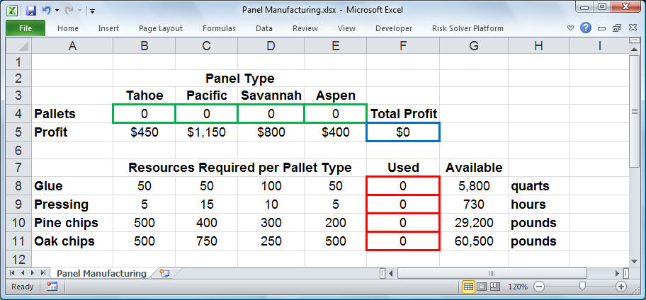
Product Mix Example

Slide 42
Product Mix Example
 | Panel Type
 | Tahoe | Pacific | Savannah | Aspen
Pallets | 0 | 0 | 0 | 0 | Total Profit
Profit | $450 | $1,150 | $800 | $400 | $0
 | Resources Required per Pallet of Paneling Type |  |  |  | Used | Available | Units
Glue | 50 | 50 | 100 | 50 | 0 | 5800 | quarts
Pressing | 5 | 15 | 10 | 5 | 0 | 730 | hours
Pine chips | 500 | 400 | 300 | 200 | 0 | 29200 | pounds
Oak chips | 500 | 750 | 250 | 500 | 0 | 60500 | pounds

Slide 43
Product Mix Example
The profit for each pallet of panels is Tahoe, $450, Pacific, $1,150, Savannah, $800, and Aspen, $400.
The objective function is computed in cell F5 as: =SUMPRODUCT(B5:E5,B4:E4)

Slide 44
Product Mix Example
In cells B8:E11, we've entered the amount of resources needed to produce a pallet of each type of panel.
For example, the value 15 in cell C9 means that 15 hours of pressing is required to produce a pallet of Pacific style panels.

Slide 45
Product Mix Example
The formulas to compute the amount of resources used based on the solution are entered in cells F8 – FF11. For example, the formula for cell F8: =SUMPRODUCT($B$4:$E$4,B8:E8)
In cells G8:G11, we've entered the available amount of each type of resource (corresponding to the right hand side values of the constraints).
This allows us to express the constraints shown earlier as: F8:F11<=G8:G11
This is equivalent to the four constraints: F8<=G8, F9<=G9, F10<=G10, and F11<=G11.

Slide 46
Product Mix Example
We can enter this set of constraints directly in the Solver dialogs along with the non-negativity conditions:
B4:E4 >= 0

Slide 47
Product Mix Example
Using Solver
In the By Changing Variable Cells edit box, we type B4:E4 or select these cells with the mouse
To add the constraints, we click on the Add button in the Solver Parameters dialog and select cells F8:F11 in the Cell Reference edit box (the left hand side), and select cells G8:G11 in the Constraint edit box (the right hand side); the relation <= is OK.

Slide 48
Product Mix Example
Showing Formulas
 | Panel Type
 | Tahoe | Pacific | Savannah | Aspen
Pallets | 0 | 0 | 0 | 0 | Total Profit
Profit | 450 | 1150 | 800 | 400 | =SUMPRODUCT($B$4:$E$4,B5:E5)
 | Resources Required per Pallet of Paneling Type |  |  |  | Used | Available | Units
Glue | 50 | 50 | 100 | 50 | =SUMPRODUCT($B$4:$E$4,B8:E8) | 5800 | quarts
Pressing | 5 | 15 | 10 | 5 | =SUMPRODUCT($B$4:$E$4,B9:E9) | 730 | hours
Pine chips | 500 | 400 | 300 | 200 | =SUMPRODUCT($B$4:$E$4,B10:E10) | 29200 | pounds
Oak chips | 500 | 750 | 250 | 500 | =SUMPRODUCT($B$4:$E$4,B11:E11) | 60500 | pounds

Slide 49
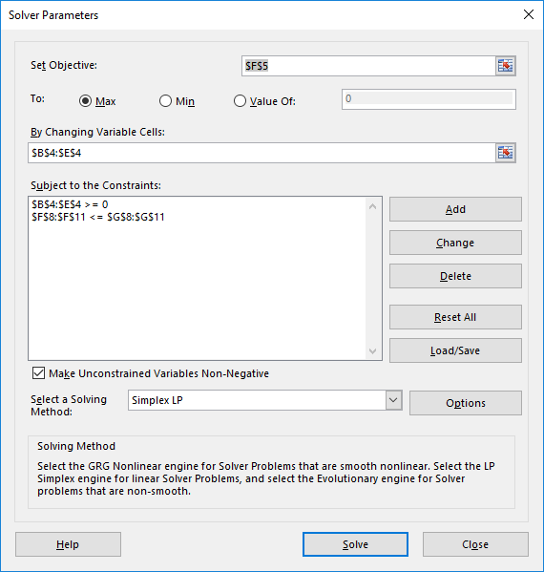
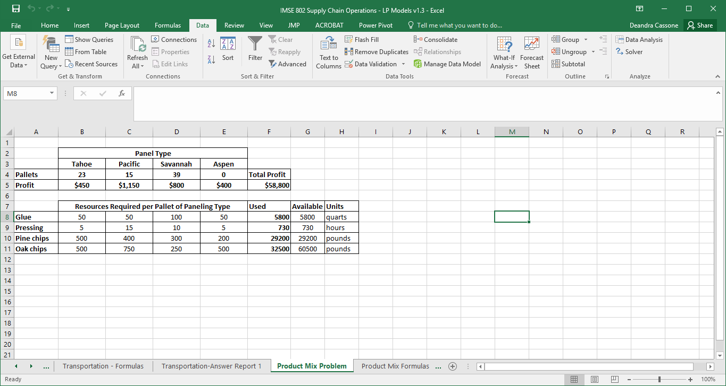
Product Mix Example

Slide 50
Product Mix Example
Using Solver
To find the optimal solution, we click on the Solve button.
This means that we should build
23 pallets of Tahoe panels
15 pallets of Pacific panels
39 pallets of Savannah panels
0 pallets of Aspen panels.
This results in a total profit of $58,800

Slide 51
Product Mix Example
Answer Report
We can generate an Answer Report by clicking on "Answer" in the Reports list box.
This report shows the original and final values of the objective function and the decision variables, as well as the status of each constraint at the optimal solution.
The constraints on glue, pressing, and pine chips are binding and have a slack value of 0.
There were 28,000 pounds of oak chips left over.
If we could obtain additional glue, pressing capacity, or pine chips we could further increase total profits.

Slide 52
Product Mix Example
Objective Cell (Max)
 | Cell | Name | Original Value | Final Value
 | $F$5 | Profit Total Profit | $58,800 | $58,800
Variable Cells
 | Cell | Name | Original Value | Final Value | Integer
 | $B$4 | Pallets Tahoe | 23 | 23 | Contin
 | $C$4 | Pallets Pacific | 15 | 15 | Contin
 | $D$4 | Pallets Savannah | 39 | 39 | Contin
 | $E$4 | Pallets Aspen | 0 | 0 | Contin
Constraints
 | Cell | Name | Cell Value | Formula | Status | Slack
 | $F$8 | Glue Used | 5800 | $F$8<=$G$8 | Binding | 0
 | $F$9 | Pressing Used | 730 | $F$9<=$G$9 | Binding | 0
 | $F$10 | Pine chips Used | 29200 | $F$10<=$G$10 | Binding | 0
 | $F$11 | Oak chips Used | 32500 | $F$11<=$G$11 | Not Binding | 28000
 | $B$4 | Pallets Tahoe | 23 | $B$4>=0 | Not Binding | 23
 | $C$4 | Pallets Pacific | 15 | $C$4>=0 | Not Binding | 15
 | $D$4 | Pallets Savannah | 39 | $D$4>=0 | Not Binding | 39
 | $E$4 | Pallets Aspen | 0 | $E$4>=0 | Binding | 0
Answer Report

Slide 53
Warehouse and Inventory Level Optimization Model

Slide 54
General Modeling Overview
Preliminary Fact Finding
Group Decision Making
1. Solving the Right Problem
(Find out what you know and don’t know)
Translate goals and objectives into criteria or measures of success
Metrics Identification to Measure Criteria
Data Sources Identification to Support Metrics
2. Measuring Success in Accomplishing the Objectives (their Metrics)
3. What is the Decision to be Made?
May require re-definition
Automated Data Sources
Expert Opinions
Surveys/Data Gathering
Interaction Between Model Structure and Data to Support Model.
4. Data Mining and Statistical Analysis – (Look at the data first. The answer may be obvious and you don’t need further analysis.)
5. Selection of Best Decision Methodologies
6. Select the Best Method that the Data will Support and Imbed in a Dynamic Model.
Automate the Decision Process
7. Model to Support Decision Process
Ability for “What - If” and Sensitivity Analysis
8. Insure Decisions that Support the Objectives with Appropriate Measures of Success

Slide 55
General Modeling Overview
Key aspects of this process are helpful in developing models that result in real-world models
Solve the right problem
Measure success in accomplishing objectives
What is the decision to be made?
Data mining and statistical analysis
Selection of the best decision methodology
Select the method that the data will support and embed it in a dynamic model
Model to support the decision process
Insure the methods support the objectives with appropriate measure of success

Slide 56
Warehouse and Inventory Level Optimization Study
System Overview
The two objectives in the problem were to minimize cost of operations and to maximize customer satisfaction (or minimize customer dissatisfaction)
The problem was to determine the size of the warehouse needed for a brewing company.
On the surface, this appears to be a relatively simple problem
To solve this is a much more complicated question that includes issues such as customer demand, brewing and packaging variability, safety stock levels and product preferences.
To develop a model, we need to define the real problem, identify available data, analyze the data and statistical analysis, select the appropriate modeling methodologies and integrate these components into a general decision model.

Slide 57
Warehouse and Inventory Level Optimization Study
General Concept of the System
The general concept of the system is to establish the safety stock and inventory level required to support the desired service level to the wholesalers.
As statistical analysis was done on the production forecast and actual production and sales to measure their variability for establishing safety stock requirements.
Once this is done, the production of products is measured as they flow through brewing, packaging, warehousing and distribution to dynamically determine the optimal Full Goods Days Inventory as an output of the system.

Slide 58
Warehouse and Inventory Level Optimization Study
General Concept of the System
To accomplish this, three major steps must be accomplished:
Analyze the demand and determine the optimal safety stock required to support a desired service level.
Perform a weekly trade-off analysis between cost and out-of-stock lost sales to refine the safety stock requirements when all demand cannot be met. (MODM model)
Follow the flow through the entire process with an expert system to understand how the inventory fluctuates on individual shifts.

Slide 59
Warehouse and Inventory Level Optimization Study
Safety Stock Determination Overview
Data was analyzed to determine the variation in what was forecast and what was actually produced and the variation in sales.
A combined variation in production and sales is required for the analysis.
Because of the high dependency of brewing with packaging and data issues, both were identified as production variability.
Data was used to try to match forecast with actual data. This was done with a fair amount of time and some difficulty.

Slide 60
Warehouse and Inventory Level Optimization Study
Safety Stock Determination Overview
The variability being captured was unplanned variability in production and sales. Safety stock covers unplanned variability. Buffer stock covers planned variability.
We needed to measure the desired production amounts and the actual production amounts.
Orders and production were matched at three weeks out. Prior to this, orders drive production, after this, production drives orders.

Slide 61
Warehouse and Inventory Level Optimization Study
Safety Stock Determination Overview
In this environment, the following general statistical analysis was selected.
1. Capture sales across all wholesalers to develop the sales distribution by product and container and calculate σ * the variability in sales.
2. Match the forecast production for each product with the production three weeks later. Fit a least squares model that predicts actual production from forecast production.
Calculate the expected production AP as a function of forecasted production.

Slide 62
Warehouse and Inventory Level Optimization Study
Safety Stock Determination Overview
In this environment, the following general statistical analysis was selected.
4. Calculate σ* the variability of production for each product.
5. Calculate the combined variability of production and sales.
z = σ ²+ σ*²
6. With this estimate of production and sales variability, the distribution can then be developed and the desired safety stock levels for each product determined. An acceptable frequency of stock-outages for each product P(z > z_{c}) where z_{c} is the combined safety stock of the wholesalers and brewery would then be determined.

Slide 63
Warehouse and Inventory Level Optimization Study
Safety Stock Data Analysis
A thorough analysis of existing planning and operating systems was conducted.
The model transcended each level of the organization from management to operations to sales therefore data was required for each level of the organization.
Planning forecast and actual production were analyzed including:
Brewing - Planned and Actual, Linear programming model used in planning
Production - Planned and Actual, Production Scheduling
Orders - Planned and Actual
Wholesaler Sales - Actual
Wholesaler Inventory Levels - Actual

Slide 64
Warehouse and Inventory Level Optimization Study
Safety Stock Data Analysis
Data was extracted and tabulated to compare forecasted quantities to actual quantities on a daily basis and was used to minimize large variability and missing data.
Management initiated a corrective action plan for systems based on this analysis.

Slide 65
Warehouse and Inventory Level Optimization Study
Safety Stock Computations
This was developed as a planning model and management tool.
The statistical analysis to measure variability in manufacturing and sales required an in-depth review and careful consideration to avoid overstating or understating safety stock.
Actual production was plotted against forecast production taking into account the three week time lag between forecasted or planned production and the actual production.
From the plot, one can determine whether a simple linear model is a good choice.
If a linear model is good, it can be fit by using least squares regression and the variability can be estimated by the residual mean square from the fitted regression model.

Slide 66
Warehouse and Inventory Level Optimization Study
Safety Stock Computations – Calculation Procedure

Slide 67
Warehouse and Inventory Level Optimization Study

Slide 68
Warehouse and Inventory Level Optimization Study
Determine the Trade-off Optimal Product Mix
From the analysis of sales and production, the unconstrained safety stocks were determined.
These were the amount to cover variability if there were no limitations on brewing and packaging capacity and constraints of warehouse space.
To determine how and by how much to reduce the theoretical safety stock, an optimal trade-off between the two conflicting objectives, to minimize cost and to minimize stock outages was required.

Slide 69
Warehouse and Inventory Level Optimization Study
Determine the Trade-off Optimal Product Mix
A Multiple Objective Decision Making Model with constraints was developed to do this.
The model was developed for a one week time period.
The model had brewing, packaging and warehouse constraints and the demand requirements
Demand includes the demand plus the difference in safety stock requirements and beginning inventory.

Slide 70
Warehouse and Inventory Level Optimization Study
Determine the Trade-off Optimal Product Mix (Form of MODM Model)
MODM Model for Optimal Product Mix
Min Stock
-
Outages
Brewing
Packaging
Warehouse
and Sales
Requirement
Min Cost
$/M BBL
$/Pallet
$/Case
of products
Brewing
>=
with safety
stock and
Constraints
=
B
ij
minimum
<=
stocking level.
Packaging
>=
Optimum
____________
Product
____________
Constraints
=
P
ij
Mix
____________
<=
____________
Warehouse
>=
Constraints
=
W
ij
<=
Given seasonality,
Product
=
planning period and
Demand
=
S
promotion effects
=
ij
Full Goods
Days
Input from
Where
B
,
P
,
W
and
S
=
Model will force a minimum
Inventory
safety stock
ij
ij
ij
ij
Capacity
determination
Brewing, Packaging, Warehouse and
stocking level at the Brewery
Sales variables (tanks, products,
and Warehouse
packaging lines, capacities, etc.)

Slide 71
Warehouse and Inventory Level Optimization Study
Determine the Trade-off Optimal Product Mix (Form of MODM Model)
Sometimes demand exceeds capacity and no safety stock replenishment can occur and beginning inventory was used to cover it.
The demand in the model was the production requirements which equals the actual demand + safety stock – beginning inventory
Samples were taken from distributions for both the beginning inventory for the wholesaler and warehouse and from the product demand for the aggregate wholesaler.

Slide 72
Warehouse and Inventory Level Optimization Study
Determine the Trade-off Optimal Product Mix (Form of MODM Model)
Safety stock for the products was selected and production requirements by product and container were computer.
A number of sample points were taken to create the distribution of safety stock that is possible to maintain based on the constraints.
During low demand – all safety stock was produced. During high demand – the MODM model was run to trade-off the objectives
Expected demand plus safety stock was the demand requirement for the week

Slide 73
Warehouse and Inventory Level Optimization Study
Output of MODM Model – Optimal Strategy

Slide 74
Warehouse and Inventory Level Optimization Study
Expert System to Track Process Flow by Shift
An expert system was used as a simulation model to track the product through the entire process by shift to determine inventory levels.
This was done for a single week application.
The results from the previous step, the MODM model, was the expected value for the safety stock for each product.
This amount was used in the simulation with random demand samples to generate the distribution of full goods days inventory.

Slide 75
Warehouse and Inventory Level Optimization Study
Expert System to Track Process Flow by Shift
The expert system had a number of steps involved.
A random sample of total demand was generated from each wholesaler for a week. (Including the % distribution of products across all wholesalers.)
The sample demand was adjusted for the safety stock value and run through a LP model to insure no constraints were violated. The single objective of this model was product priority.

Slide 76
Warehouse and Inventory Level Optimization Study
Expert System to Track Process Flow by Shift
Expert System Steps (continued)
Given the sample satisfied the constraints, the flow of product by shift is traced through packaging, warehousing and distribution. Methods and rules of operation were modeled including
Beer availability
Priority of order
Assignment to the packaging line
Line efficiency
Number of doors and train sidings

Slide 77
Warehouse and Inventory Level Optimization Study
Expert System to Track Process Flow by Shift
Expert System Steps (continued)
Inventory levels were captured by product by shift.
The process was repeated until enough samples were generated to adequately develop the distributions for Full Goods Days Inventory. This included automatically developing of the mean and standard deviation.

Slide 78
Warehouse and Inventory Level Optimization Study
Expert System to Track Process Flow by Shift

Slide 79
Warehouse and Inventory Level Optimization Study
Expert System to Track Process Flow by Shift

Slide 80
Warehouse and Inventory Level Optimization Study
Expert System to Track Process Flow by Shift

Slide 81
Warehouse and Inventory Level Optimization Study
Sensitivity Analysis
The model integrated a number of different planning and operating systems under one umbrella and took a corporate wide view of operations.
Warehouse requirements, in a sense, are the combination of all other variations in the operating processes
The model was developed as a planning model.

Slide 82
Warehouse and Inventory Level Optimization Study
Sensitivity Analysis
Types of what-if analysis and parameters that could be changed by the model included:
Parameters for brewing, lines, shifts, wholesalers and product codes.
Objective weights
Capacities and constraints for warehouse, brand, line, brewing duration and product code distribution.
Historical distributions that had uses in other areas included demand, warehouse beginning inventory, wholesaler inventory and wholesaler sales distributions.

Slide 83
Warehouse and Inventory Level Optimization Study
Benefits
Insures adequate supply of product to the wholesalers for a growing number of products
Accurately determines the Full Goods Days Inventory needed to provide input on the necessary warehouse space.
Allowed management to determine the optimal amount of inventory to be maintained at both the brewery and wholesaler.
Improves scheduling of brewery and packaging and distribution

Slide 84
Warehouse and Inventory Level Optimization Study
Benefits
Provides an analysis tool to test changes in the operation before they are put in place to avoid costly errors.
A “predictive model” for determining the optimal inventory level at a brewery.
An interactive tool that allowed management to do “what-if” analysis for changes in operations.
Allowed management to study the impact of introducing new products, changes in operations and changing product demand for wholesalers.

Slide 85
References
https://www.linearprogramming.info/example-of-a-product-mix-problem-in-linear-programming/
https://www.youtube.com/watch?v=YQgKh1qdFEU
https://www.solver.com/solver-tutorial-solver-model-using-product-mix-example

Slide 86
References
https://conspecte.com/Supply-Chain-Management/supply-chain-design-and-analysis-models-and-methods.html
http://www.orms-today.org/orms-4-02/frvaluechain.html
https://www.sciencedirect.com/science/article/pii/S037722171300787X
Case Study: Optimization Models in Supply Chain Risk Management
Optimization Methods in Supply Chain Applications: a Review, Conference Paper, Dublin Institute of Technology, Amr Arisha and Waleed Abo-Hamad, 12th Annual Conference of the Irish Academy of Management, Galway Mayo Institute of Technology, Galway, 2-4 September 2009.

Slide 87
IMSE 802 Supply Chain Operations and Decision Making
Lecture 3
Supply Chain Models

